Slide 1
Text Mining Analysis on Yelp Restaurant Reviews and Rating Prediction
Master Final Oral Exam
Wei Hu
Major Professor: M.Q. Meeker
04-12-2017
Notes:
Good afternoon, Prof. Meeker, Prof. Wang and Prof. Wu. Thank you very much for being my committee members and attending my final exam. Today the topic of my creative component is

Slide 2

About Me
ISU PhD in Materials Science and Engineering in 2011
Dallas Area (Plano TX)
Work in Capital One Home Loan
Principal Data Analyst
Loan Origination
Customer Experience
Compliance and Risk
Iowa State University
Department of Statistics
Notes:
Let me introduce myself a little bit. I received my PhD degree in Materials Science and Engineering in 2011. My PhD study involves data-driven design of materials and experimental validation, that is when I become interested in the statistics. Currently I am working with Capital One Home Loan department in the Dallas area. Right now I am a principal data analyst to support loan origination, customer experience and compliance. In my daily work I dealt with a lot of structured data from the database. On the same time we also have a lot of unstructured data, like customer views and loan processing notes. How to utilize these data efficiently, that is the reason I am interested in text mining and want to do further study in this area.

Slide 3
Table of Content
Introduction
Background of Text Mining
Data Description
Preprocessing
Feature Extraction
Predictive Analysis
Conclusion
Iowa State University
Department of Statistics

Slide 4
Introduction
Iowa State University
Department of Statistics

Slide 5
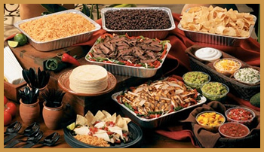






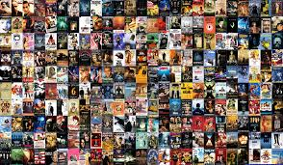


Today online customer reviews provide much larger review coverage and convenient access for potential customers
Iowa State University
Department of Statistics
Notes:
Today we can find lots of review website on the internet. For example, the Yelp review for restaurant and foods, trip advisor for attractions and hotels, IMDB for the movie and TV drama, and almost all the online shopping site allow previous customers to leave reviews. Compared to traditional review magazine, the online customer review provide much larger review coverage and convenient access for potential customers

Slide 6
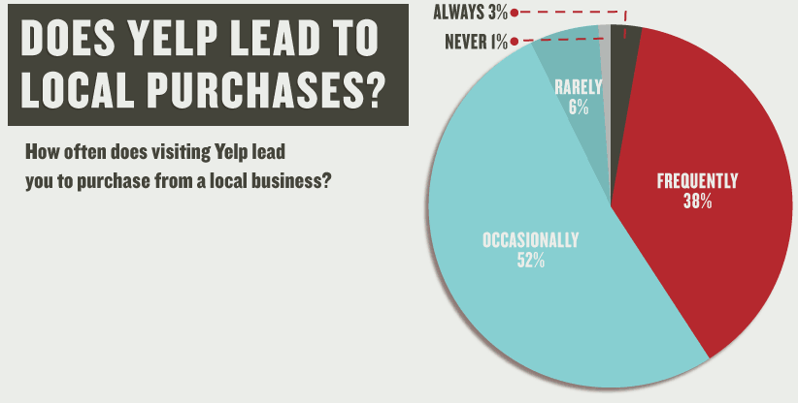
Online customer reviews have tremendous impacts on reputation and revenue of products and local businesses
San Francisco metropolitan area, a Yelp rating increase from 3.5 to 4 can cause restaurants to sell out table reservations 19% more frequently
Another study in the Seattle area found that a one-star increase in Yelp rating leads to a 5 to 9 percent increase in revenue for non-chain restaurants and an increasing Yelp coverage to the local market actually can cause a market share decline for the chain restaurants
https://www.wiideman.com/blog/local-seo/study-how-important-are-yelp-reviews-really
Anderson, M. and Magruder, J. (2012), Learning from the crowd: Regression discontinuity estimates of the effects of an online review database,
The Economic Journal, 563, 957–989
Luca, M. (2011), Reviews, Reputation, and Revenue: The Case of Yelp.com, Harvard Business School NOM Unit Working Paper No. 12-016
Iowa State University
Department of Statistics
Notes:
On the other hand, Online customer reviews have tremendous impacts on the customer behavior and then the reputation and revenue of products and local businesses. According to a recent survey, 38% of Yelp user frequently made purchase after their Yelp visit. San Francisco metropolitan area, a Yelp rating increase from 3.5 to 4 can cause restaurants to sell out table reservations 19% more frequently; Another study in the Seattle area found that a one-star increase in Yelp rating leads to a 5 to 9 percent increase in revenue for non-chain restaurants and an increasing Yelp coverage to the local market actually can cause a market share decline for the chain restaurants;
Therefore how to analyze the customer reviews and make corresponding improvement is very important to a customer centric business. However, the traditional human review evaluation process is labor intensive and time-consuming when the reviews volume is huge and updates frequently. That is the reason I want to use text mining technology to automatically analyze reviews (4.30mins)

Slide 7
Background of Text Mining
Iowa State University
Department of Statistics

Slide 8
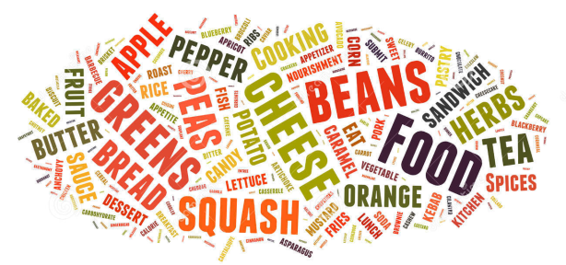



Subjects of text mining : words, document, corpus, dictionary
Word, punctuation
Document
Dictionary: collection of distinct words in a corpus
Text Corpus
Iowa State University
Department of Statistics
Notes:
The subjects of text mining are different levels of texts. The basic level is character, punctuation and words, which form a written representation of thoughts, a document. In the current study, one customer’s review is one document, which could have multiple sentences or paragraphs. The term text corpus is used to describe a large collection of documents [3], which could be a collection of reviews for a particular restaurant or reviews of many restaurants across US. a dictionary is The collection of unique words in a corpus.

Slide 9

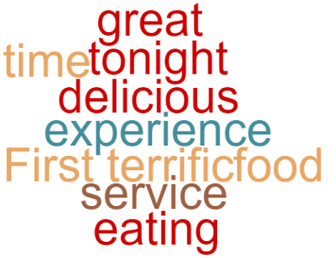
Text Representation: Bag of words
Unigram Vector
Time First
Word | Frequency
, | 1
. | 2
a | 1
and | 2
delicious | 1
eating | 1
experience | 1
food | 1
great | 1
it | 1
service | 1
terrific | 1
the | 2
there | 1
time | 1
tonight | 1
was | 3
First time eating there tonight, and it was a great experience.
The service was terrific and the food was delicious.
The syntax of the sentence is intentionally ignored for simplicity and efficiency
The order of words can be changed without impacting the outcome of vector representation.
Iowa State University
Department of Statistics
Notes:
In text mining, the text is represented as a bag of words. For example, these two sentences of reviews, “First time eating there tonight, and it was a great experience. The service was terrific and the food was delicious.”
can be broken down and reorganized into a bag of words, more specifically a vector with unique words and punctuation with their frequencies. Here the syntax of the sentence is intentionally ignored for simplicity and efficiency. If you exchange the order of two words, like put the ‘time’ in front of ‘first’. It does not impact the outcome of vector representation. The vector appears here only consider single word or punctuation, so it is also called unigram vector.

Slide 10
Text Representation: N-gram, Unigram, Bigram and Trigram
Unigram
Bigram
Trigram
Word | Frequency
, | 1
. | 2
a | 1
and | 2
delicious | 1
eating | 1
experience | 1
food | 1
great | 1
it | 1
service | 1
terrific | 1
the | 2
there | 1
time | 1
tonight | 1
was | 3
Word | Frequency
, and | 1
. the | 1
a great | 1
and it | 1
and the | 1
delicious . | 1
eating there | 1
experience . | 1
first time | 1
food was | 1
great experience | 1
was delicious | 1
was terrific | 1
it was | 1
service was | 1
terrific and | 1
the food | 1
the service | 1
there tonight | 1
time eating | 1
tonight , | 1
was a | 1
Word | Frequency
, and it | 1
. the service | 1
a great experience | 1
and it was | 1
and the food | 1
eating there tonight | 1
experience . the | 1
first time eating | 1
food was delicious | 1
great experience . | 1
was delicious . | 1
was terrific and | 1
it was a | 1
service was terrific | 1
terrific and the | 1
the food was | 1
the service was | 1
there tonight , | 1
time eating there | 1
tonight , and | 1
was a great | 1
Iowa State University
Department of Statistics
Notes:
In the bag of word model, the sequence of words does not matter, while the n-gram models provide alternatives to consider the local word order, which breaks down the text into a contiguous sequence of n words. The most commonly used n-gram models are bigram and trigram. Apparently the bigram and trigram could tell us more information than a unigram.

Slide 11
Text Representation: Vector based on a text corpus
Corpus
First time eating there tonight, and it was a great experience.
The service was terrific and the food was delicious.
Unigram
Word | Frequency
, | 0
. | 1
a | 0
and | 1
delicious | 1
eating | 0
experience | 0
food | 1
great | 0
it | 0
service | 1
terrific | 1
the | 2
there | 0
time | 0
tonight | 0
was | 2
Document
The service was terrific and the food was delicious.
Zeros
For
words
not in doc
Iowa State University
Department of Statistics
Notes:
Usually a document is represented in the context of a corpus. For example, if we consider these two sentences as corpus, then the second sentence as the document. It can be represented as a vector having zeros for the words in dictionary but not in doc. You can image if the corpus is huge and this vector will be a sparse vector having lots of zeros

Slide 12
Topic Modeling and Extraction
Topic is the subject of conversation or discussion in the text
Practically considered as recurring patterns of co-occurring words in a corpus
90%
Topic ‘Service’
A restaurant review could be considered as 10% about the service and 90% about the food quality, if there are about 9 times more food words than service words.
10%
Topic ‘Food Quality’
Iowa State University
Department of Statistics
Notes:
To automatically capture the subject that a document is talking about, in text mining, is called topic extraction. In text mining, topics are practically considered as recurring patterns of co-occurring words in a corpus. For example, "service" and "waiter" will appear more often in reviews about service, "taste" and "delicious" will appear more often in reviews about foods quality. A document typically consists of multiple topics in different proportions. A restaurant review could be considered as 10% about the service and 90% about the food quality, if there are about 9 times more food related words than service related words.

Slide 13

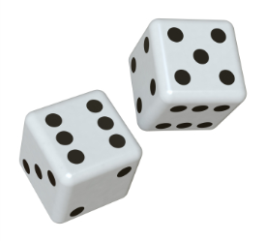
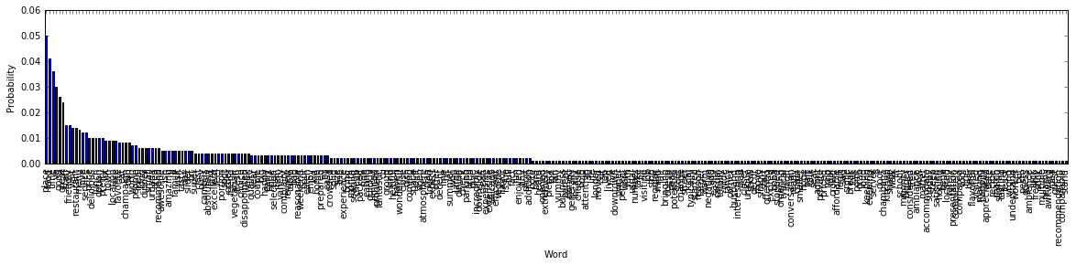
Generative Statistical Model
A model for randomly generating observable text given certain hidden parameter
Unigram Model
assumes that each document is formed by generating each word independently
‘It was a great experience’
p(‘it’, ‘was’, ‘a’, ‘great’, ‘experience’)
= p(‘it’) p(‘a’) p(‘great’)p(‘experience’)
Probability of each word evaluated
based on the entire corpus
Iowa State University
Department of Statistics
Notes:
One way to extract the topic is to build generative model. A model for randomly generating observable text given certain hidden parameter. The simplest one is the unigram model, assuming that each document is formed by generating each word independently. Probability of generating a sentence ‘It was a great experience’ can be calculated by multiplying the probability of each word evaluated based on the entire corpus.

Slide 14
Generative Model: LDA (Latent Dirichlet Allocation) Model
Widely used, introduced in 2003
Assume one document could consist of multiple topics
Three level Bayesian hierarchical model
Documents
d₁
d₂
d₃
d₄
%
%
%
Per-Document Topic Distribution
Topics
t₁
t₂
t₃
%
%
%
%
Per-Topic Words Distribution
Words
w₁
w₂
w₃
w₄
Iowa State University
Department of Statistics
Notes:
Latent Dirichlet Allocation model, the LDA, is a widely used generative model for topic extraction. It was introduced in 2003, Assume one document could consist of multiple topics, it employs a three level Bayesian hierarchical model. One document can have multiple topics. And each topic is essentially a word distribution over the entire dictionary

Slide 15




LDA Generative Process
Initiate:
Assume there are K latent topics in the studied text corpus
To generate a word $w_{j, k}$ in document $j$ position $k$
Assume each word is generated by one topic
Choose a topic first.
Per-document topic distribution is a multinomial distribution with one draw with parameter vector $θ_{j}$, topic probabilities.
Per-document topic distribution
Document
d_{j}
$$t_{j, k}\sim Multinomial\left({1, θ}_{j}\right)={θ_{1}}^{t_{1}}…{θ_{K}}^{t_{K}}$$
%
%
%
$$\sum_{m=1}^{K}{t_{m} }=1$$
Draw one topic
Topics
t₁
t₂
t₃
$$\sum_{m=1}^{K}{θ_{j, m} }=1$$
Topic probabilities
Iowa State University
Department of Statistics
Notes:
The process for LDA to generate a corpus is like this. First to initiate a fixed number of topics K, this is the major parameter for LDA . To generate a word $w_{j, k}$ in document $j$ , position $k$, firstly assume each word is generated by one topic, and then its topic follow a multinomial distribution with one draw. Its parameter theta j is topic probability in the document j.

Slide 16



Generative Model: LDA
To generate a word $w_{j, k}$:
Generate the word based on per-topic words distribution
per-topic words distribution is a multinomial distribution with one draw with parameter vector${ p}_{i}$, word probabilities.
Topics
t_{i}
Per-Topic Words Distribution
$$w_{j, k}\sim Multinomial\left(1, p_{i}\right)={p_{1}}^{w_{1}}…{p_{V}}^{w_{V}}$$
%
%
%
Words
w₁
w₂
w₃
$$\sum_{n=1}^{V}{w_{n} }=1$$
Draw one word
$$\sum_{n=1}^{V}{p_{n} }=1$$
Word probabilities
Iowa State University
Department of Statistics
Notes:
After choosing a topic, for example, topic i, then word can be drawn from the word distribution of topic i, which is a multinomial distribution with one draw, the parameter of which is the word probability in topic i. The V here is the size of dictionary

Slide 17
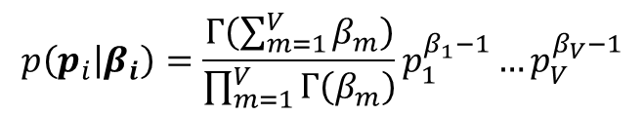
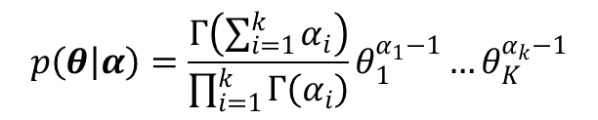

LDA: Generative Process
Set Dirichlet prior for topic probabilities $θ$ with parameter vector $α$
Set Dirichlet prior for word probabilities $p_{i}$ in $i$th topic with parameter vector$β_{i}$
$$p\left(θ | α\right)=\frac{Γ\left(\sum_{i=1}^{k}{α_{i}}\right)}{\prod_{i=1}^{k}{Γ\left(α_{i}\right)}}θ_{1}^{α_{1}−1}…θ_{K}^{α_{k}−1}$$
$$p\left(p_{i} | β_{i}\right)=\frac{Γ\left(\sum_{m=1}^{V}{β_{m}}\right)}{\prod_{m=1}^{V}{Γ\left(β_{m}\right)}}p_{1}^{β_{1}−1}…p_{V}^{β_{V}−1}$$
Iowa State University
Department of Statistics

Slide 18
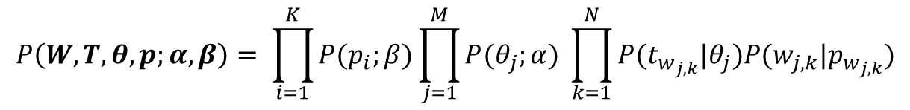

LDA: Parameter Estimate
Assume all the words are generated independently, the total probability to generate all the words in all the documents in a text corpus
Parameter vector $α$ and matrix $β$ can be estimated using Expectation Maximization (EM) method.
$$P\left(W, T, θ,p;α,β\right)= \prod_{i=1}^{K}{P(p_{i};}β)\prod_{j=1}^{M}{P(θ_{j};}α) \prod_{k=1}^{N}{P(t_{w_{j,k}}|θ_{j})P(w_{j,k}|p_{w_{j,k}})}$$
Word Level
Document Level
Topic Level
Iowa State University
Department of Statistics
Notes:
And then follow the same assumption we mentioned before, assume all the words are generated independently, then the total probability to generate all the words in all documents in a text corpus is like this equation. We see this part of equation is for the word level, and then document level, in the end is the topic level. We can see this equation is based on two parameters, vector alpha and metrix beta, they can be estimated using the expectation maximization method.

Slide 19
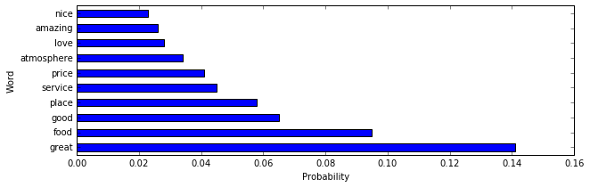

LDA Topic Extraction Results
Word probabilities $p$over entire dictionary for each topic
E.g. 384 words with non-zero probability from 19175 distinct words dictionary
Usually only first 10 probable words will be displayed.
In this case, accounts for 26.5% of total frequency
The proportions of topics (topic probabilities) $θ$for a particular document
Iowa State University
Department of Statistics
Notes:
After we get the alpha and beta, we can further estimate the Word probabilities $p$over entire dictionary for each topic, for example, here we have a corpus containing 19175 distinct words, one of the topics extracted contains 384 words with non-zero probabilities. It is a pretty long vector, so usually only the first 10 probable words will be displayed, in this case, they accounts for 26% of total frequency. And also for each document, the proportion of each topic can be derived. As we mentioned before a document can contain 10% of topic 1 and 90% of topic 2

Slide 20
Sentimental Analysis
Analyze reviewer’s emotion and sentimental polarity
Most obvious indicators:
Positive words: ‘good’, ‘awesome’, ‘delicious’ , ‘ymmmmy’ , ‘☺’
Negative words: ‘bad’, ‘awful’, ‘terrible’
Phrases and idioms: ‘piece of cake’ , ‘not my cup of tea’
A important approach is to compare the documents against a collection of sentimental words and phrases, that is, a sentiment lexicon
The current study utilized the VADER (Valence Aware Dictionary for sEntiment Reasoning) lexicon
Introduced in 2014 based on existing well-established and human-validated sentiment lexicons with additional lexical features in social media
7500 lexical features, including regular single words, abbreviations like ‘plz’, emoticons like “:)” and “:-(“, and social media morphology of words
Sentiment polarity was scored on a scale of [-4, 4] for each lexical feature based on statistical results of human rating under careful training and strict quality control procedures
Iowa State University
Department of Statistics
Notes:
(15mins) While topic modeling focus on the meaning of text, sentiment analysis try to measure the reviewers’ sentimental polarity and intensity. The most obvious indictors in the text are the positive and negative words. Such as ….

Slide 21
Purpose of study
Use multiple text mining techniques to extract features from review text only
Build predictive models for review rating based on the extracted features only
Compare the influence between different extracted features and corresponding techniques.
Iowa State University
Department of Statistics
Notes:
(15mins) While topic modeling focus on the meaning of text, sentiment analysis try to measure the reviewers’ sentimental polarity and intensity. The most obvious indictors in the text are the positive and negative words. Such as ….

Slide 22
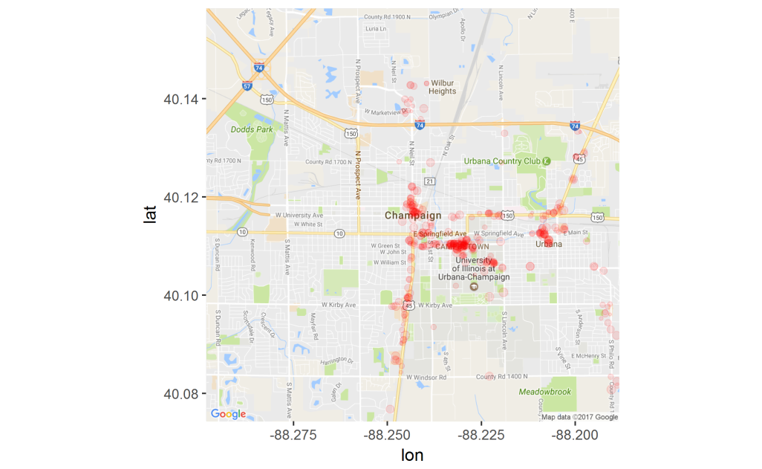
Data Description
Yelp reviews about restaurants around university of Illinois, Champaign and Urbane (UIUC), about 300 business and 11205 reviews
Business id:
Review id
Rating
Review Text
Iowa State University
Department of Statistics
Notes:
The dataset in this project was taken from Yelp data challenge, which includes restaurants, shopping centers, super markets, home services, and other local businesses. The restaurant category is the largest group and accounts for around 25% of population. The data for restaurants around university of Illinois, Champaign and Urbane (UIUC), about 300 business and 11205 reviews, were studied in this research. Because I intend to only use the review text, so only these four fields were used from dataset.

Slide 23
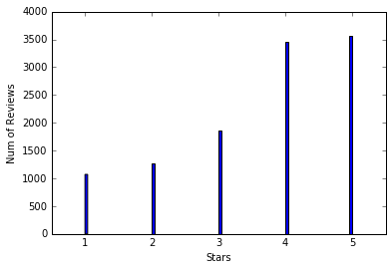
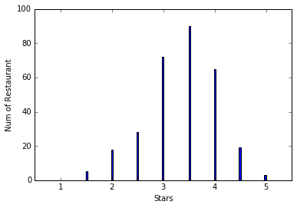
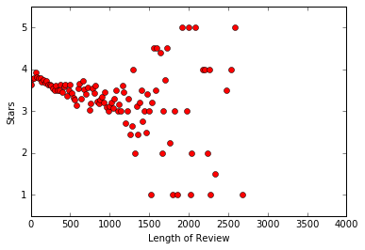
Data Description
Rating distribution of all reviews
Distribution of average rating of businesses
Rating vs Review length
reviewer giving extremely high or low ratings tend to write longer reviews to justify their ratings.
Iowa State University
Department of Statistics
Notes:
The reviews were rated from 1 to 5, while the overall rating for a business is rounded to every 0.5. The rating distribution among reviews and restaurants are shown in Figure 5, indicating that customers generally leave positive reviews. This figure shows the relationship between the lengths of the review text against the average rating for reviews of that particular length. The plot indicates that there is a steady decrease in the average rating as the number of words increases. The variation in average rating for similar length is found to be extremely high as the length increases, especially beyond 500, when compared to lower to middle lengths. It seems that reviewer giving extremely high or low ratings tend to write longer reviews to justify their ratings.

Slide 24
Data Preprocessing
Tokenizing sentences into bag of words
In text mining, documents are simply represented as bags of words. Each sentence can be converted into a vector of distinct words and words frequency.
Removing stop words and punctuations
Stop words refer to the most common words in the language which does not provide too much information for the document, such as ‘we’, ‘the’ and ‘there’. Stop words were removed against the NLTK stop words dictionary, which includes 153 words for English language
Lemmatization
Words have different forms, such as ‘do’, ‘did’ and ‘doing’, and different derivations, such as ‘memory’ and ‘memorize’. Lemmatization refers to converting different forms or derivation of words to the base or dictionary form of a word, which is known as the lemma.
Since VADER lexicon is able to evaluate the stop words and punctuation, the review texts are only tokenized before sentimental analysis.
Iowa State University
Department of Statistics
Notes:
The following data preprocessing steps were performed on the review text before analysis.

Slide 25
Feature Extraction: Bigram/Trigram Phrases
Extracted phrases provided comprehensive information about the content of customer reviews.
Bigram Phrases | Frequency
pretty_good | 629
food_good | 572
good_food | 361
great_place | 333
black_dog | 326
champaign_urbana | 308
5_star | 299
chinese_food | 284
mexican_food | 276
food_great | 272
great_food | 267
burnt_end | 262
deep_dish | 244
sweet_potato | 244
pad_thai | 243
pulled_pork | 240
love_place | 232
fried_rice | 226
service_good | 216
Trigram Phrases | Frequency
sweet_potato_fry | 162
deep_dish_pizza | 87
food_pretty_good | 75
champaign_urbana_area | 74
thin_crust_pizza | 69
chicago_style_pizza | 52
baked_potato_casserole | 47
pulled_pork_sandwich | 41
authentic_mexican_food | 35
general_tso_chicken | 34
bi_bim_bap | 34
place_champaign_urbana | 34
great_beer_selection | 32
restaurant_champaign_urbana | 30
authentic_chinese_food | 30
big_grove_tavern | 28
highly_recommend_place | 27
hot_sour_soup | 26
thai_iced_tea | 25
Iowa State University
Department of Statistics

Slide 26
Feature Extraction: LDA Topic Extraction
A topic number of 50 was used for LDA topic modeling
The five topics with highest proportion in entire corpus
Index | Topic (10 most probable words out of 19175 words dictionary) | Proportion | Manual Interpretation
29 | 0.130*beer + 0.088*bar + 0.040*drink + 0.038*selection + 0.026*place + 0.021*good + 0.021*bartender + 0.020*game + 0.018*night + 0.018*tap | 13.9% | Bar
11 | 0.033*italian + 0.014*walking + 0.013*chili + 0.011*turkey + 0.010*fault + 0.010*husband + 0.010*7 + 0.009*lunch + 0.009*pasta + 0.009*opted | 12.1% | Food-Chili
39 | 0.045*place + 0.038*nice + 0.024*table + 0.023*seating + 0.022*good + 0.018*great + 0.018*staff + 0.017*area + 0.016*spot + 0.015*sit | 13.1% | Service (Seating)
31 | 0.031*table + 0.024*time + 0.024*waitress + 0.022*asked + 0.021*food + 0.019*server + 0.018*didn + 0.018*service + 0.017*drink + 0.015*ordered' | 11.3% | Service (waiting)
45 | 0.066*cheese + 0.049*salad + 0.034*bread + 0.028*good + 0.024*sandwich + 0.018*tomato + 0.016*onion + 0.015*soup + 0.015*chicken + 0.013*lunch | 9.8% | Food-cheese
Iowa State University
Department of Statistics

Slide 27
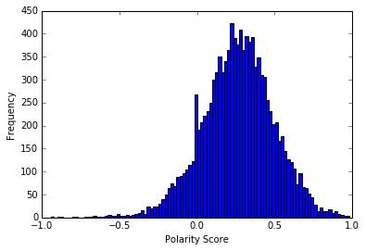
Feature Extraction: Sentimental polarity
Sentimental polarity of customers was evaluated based on a [-1,1] scale; where -1 represent absolute negative, 0 as neutral and 1 means positive.
The polarity score of each sentence was derived using VADER approach.
The polarity score of each review is derived by averaging of polarity scores of sentences
Distributions of derived sentiment polarity scores
Iowa State University
Department of Statistics
Notes:
Sentimental polarity of customers was evaluated based on a [-1,1] scale; where -1 represent absolute negative, 0 as neutral and 1 means positive.
The polarity score of each sentence was derived using VADER approach.
The polarity score of each review is derived by averaging of polarity scores of sentences.
Distributions of sentiment polarity score for a single review

Slide 28
Predictive Analysis for review rating
Review ratings in a range of 1 to 5 can be considered either numerical or categorical, as there is no distinct difference when a 1 star review is misclassified as a 2, while it is a terrible error if it is labeled as 5. Both approaches were implemented and compared.
According to methodology of Net Promoter Score(NPS), an industrial system for measuring customer experience, Ratings 1 to 3 were relabeled as ‘detractor’, 4 as ‘indifference’ and 5 as ‘promoter’ for building the classification models
Explanatory Variables to predict the rating of one review
sentimental polarity scores
length of review
600 most frequent bigram and trigram phrases
the proportion for each of the 50 topics evaluated by LDA model
Totally 652 attributes were used as explanatory variables.
Iowa State University
Department of Statistics

Slide 29
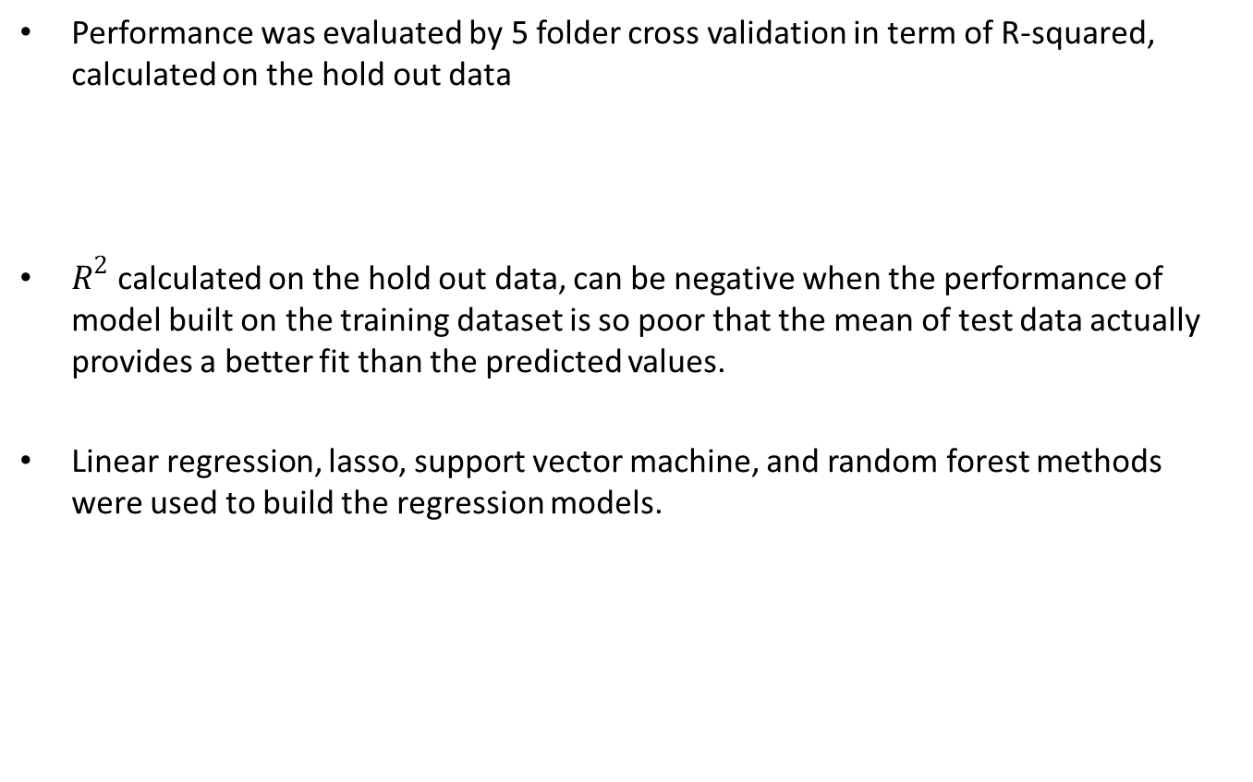
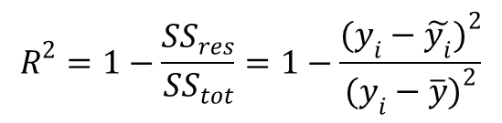
Predictive Analysis: Regression
Performance was evaluated by 5 folder cross validation in term of R-squared, calculated on the hold out data
$R^{2}$ calculated on the hold out data, can be negative when the performance of model built on the training dataset is so poor that the mean of test data actually provides a better fit than the predicted values.
Linear regression, lasso, support vector machine, and random forest methods were used to build the regression models.
$$R^{2}=1−\frac{{SS}_{res}}{{SS}_{tot}}=1−\frac{{(y_{i}−\tilde{y_{i}})}^{2}}{{(y_{i}−\overline{y})}^{2}}$$
Iowa State University
Department of Statistics
Notes:
Compared to simple linear regression, Lasso (least absolute shrinkage and selection operator)) has better performance in reducing the overfitting and better interpretation in the regression model. Lasso actually forces the sum of the absolute value of the regression coefficients to be less than a fixed value, which forces certain coefficients to be set to zero, effectively choosing a simpler model that does not include those coefficients.

Slide 30
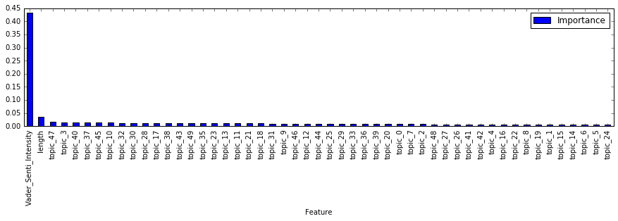
Predictive Analysis: Regression
Performance comparison: Random Forest has the best performance
The negative R² indicates that linear regression and support vector machine regression show strong sign of overfitting when applied to this data
Variables importance from Random Forest model:
Sentimental score>>review length> LDA topics>ngram phrases
Model | 5 fold Predicted R² |  |  |  |  | Average R²
Linear Regression | 0.3896 | 0.3083 | 0.3504 | -6.104 | 0.4229 | -0.92656
Lasso | 0.2170 | 0.2299 | 0.2151 | 0.1537 | 0.2430 | 0.21174
SVR | -0.0712 | -0.0027 | 0.0584 | 0.0281 | 0.0321 | 0.0089
Random Forest | 0.3813 | 0.3189 | 0.3761 | 0.3217 | 0.4460 | 0.3688
Iowa State University
Department of Statistics
Notes:
The Random Forest model allows evaluating the relative importance of variables in the model building. Figure 8 shows the 50 most important features. It could be found that the most important attribute is the derived sentiment polarity score, while the length of review is the second. The rest of the important features are the topics derived from LDA approaches. Although LDA derived topics are harder to interpret, it is obvious that they capture more useful information than the bigram and trigram phrases. Based on above observation, most influential variables for review rating are sentimental intensity extracted by VADER model, the review length and Topic models extracted by LDA. Although the calcification approach can provide slightly better performance than the regression approach, regression can provide more detailed predictions. More detailed model tuning should be done in the future.
Random Forrest model, is a tree based ensemble learning model, using the bootstrap aggregating or bagging method.
It build multiple trees on the same time and then determine the final result using the votes from different trees.
For the development of each tree, firstly it will select a random sample with replacement in the training dataset, and then randomly select a subset of variables to build the tree.
Compared by simple tree model, random forrest has much higher accurancy and much better control for the over fitting

Slide 31
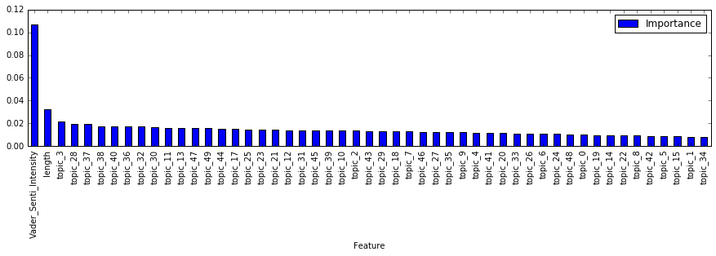

Predictive Analysis: Classification
The performance of three-class classification model is evaluated using the metric of accuracy (ACC)
$$ACC=\frac{True Positive+True Negative}{N}$$
Variables importance from Random Forest model:
Sentimental score>review length> LDA topics>ngram phrases
Model | 5 fold Accuracy |  |  |  |  | Average
Logistic regression (one vs rest) | 0.5660 | 0.5368 | 0.4908 | 0.5443 | 0.5924 | 0.5460
SVC | 0.3898 | 0.3922 | 0.3837 | 0.3908 | 0.4107 | 0.3934
Random Forest | 0.4924 | 0.4859 | 0.5227 | 0.4796 | 0.4859 | 0.4859
k-nearest Neighbors | 0.4054 | 0.4234 | 0.4011 | 0.4042 | 0.4142 | 0.4097
Iowa State University
Department of Statistics
Notes:
The performance of 3-class classification model is evaluated using the metric of accuracy. The best model actually is logistic regression. As Python Scikit-learn package does not provide a variable importance or significance test for logistical regression, the variable importance was evaluated using the Random Forest classification model, which offered second highest model performance. This figure shows the 50 most important variables in the random forrest classification model, which confirmed the observation that topics extracted from LDA models provides more information than the bigram and unigram phrases.

Slide 32
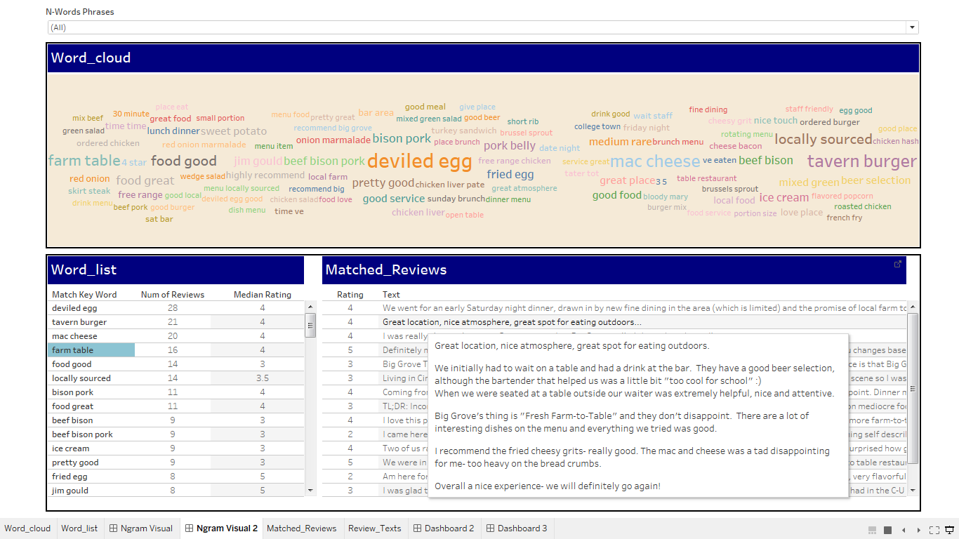
Representation and visualization of individual restaurant
With the bigram and trigram phrases extracted, a visualization tool was built using Python as data engine and Tableau as visualization platform.
Live Demo:
Most frequently mentioned dish ‘deviled egg’ with a median rating of 4
The food is ‘local sourced’ with a median rating of 3.5
The ‘portion size’ may be not so good with a median rating of 2.5.
This restaurant is also good for ‘date night’ with median rating of 4 and the review with ‘college town’ tend to have a lower review rating.
Iowa State University
Department of Statistics
Notes:
LDA extracted topics provide more comprehensive information than the unigram and trigram phrases and can be used as a text dimension reduction techniques. However, the LDA topics as word distributions are generally difficult to interpret. With the bigram and trigram phrases extracted, a visualization tool was built using Python as data engine and Tableau as visualization platform

Slide 33
Conclusion
The current study used multiple text mining techniques, such as bigram, trigram, LDA topic modeling and VADER sentimental intensity, to extract sematic features from review texts and built predictive models for review ratings on top of these features.
Sentimental intensity is most influential in the predicting the review rating
LDA extracted topics provided much more comprehensive information than the bigram and trigram phrases and can be considered as a great tool for text dimension reduction.
Bigram and trigram features, which are easier for human interpretation than the LDA topics, were used to build a word cloud visualization tool, allowing quick human browsing and evaluation for large amount of reviews of a particular restaurant.
Iowa State University
Department of Statistics

Slide 34
Thank You!

